Slide 1
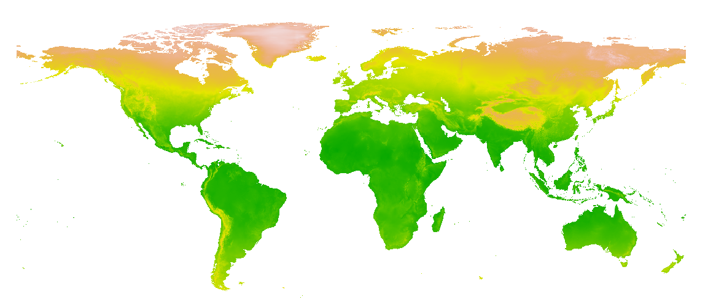
Extract spatial data in R
Paola Barajas, Wubing Xu

Slide 2
Objectives
Geographic spatial data in R
Extract Spatial data for sites (points)

Slide 3
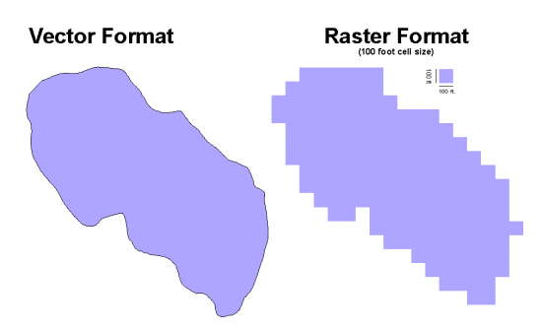
Geographic spatial data
Two major data types
Vector
Raster

Slide 4
Vector data - shapefiles
Points: SpatialPoints; SpatialPointsDataFrame
Lines: SpatialLines; SpatialLinesDataFrame
Polygons: SpatialPolygons; SpatialPolygonDataFrame
Additional attributes
Features
Features

Slide 5

Raster data
A raster is a pixel-based (grid) format with spatial information
Origin
 |  |  | 1 | 1 | 0 | 4 | 6 | 4
 |  |  | 3 | 2 | 2 | 5 | 5 | 7
 |  |  | 4 | 5 | 4 | 8 | 5 | 3
 |  |  | 4 | 2 | 6 | 6 | 4 | 3
 |  |  | 3 | 3 | 7 | 7 | 8 | 5
 |  |  | 2 | 2 | 6 | 8 | 6 | 6
 |  |  |  | 1 | 5 | 4 | 3 | 2
 |  |  |  |  |  |  | 1
Projection, datum
Resolution
Extent

Slide 6
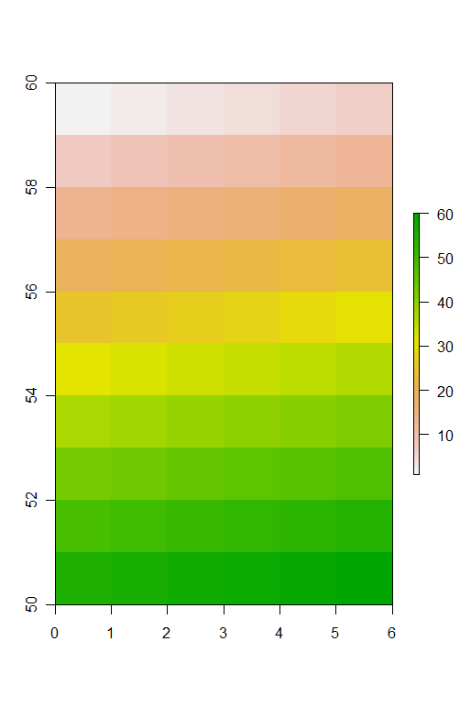
Raster data in different formats
as.matrix()
getValues()
raster()
setValues()
1 2 3 4 5 6
7 8 9 10 11 12
13 14 15 16 17 18
19 20 21 22 23 24
25 26 27 28 29 30
31 32 33 34 35 36
37 38 39 40 41 42
43 44 45 46 47 48
49 50 51 52 53 54
55 56 57 58 59 60
1
2
3
4
5
6
.
.
.
.
60

Slide 7
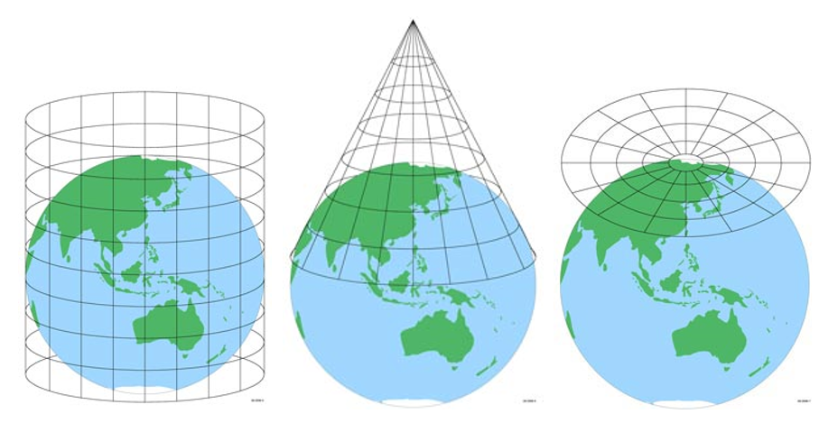
Projections
Spatial information: projection, datum
Projection describes how the spherical coordinates are flattened
Datum describes how the Earth ellipsoid is modeled
They always produce some distortion (of shape, area or direction)
Notes:
Projection, datum, ellipse
Projection describes how the spherical coordinates are flattened
Datum describes how the Earth ellipsoid is modeled

Slide 8
Projections in R
This is a system of codes to describe the projection
“+proj=longlat +datum=WGS84”
“+proj=cea +datum=NAD83 +lat_ts=30 +lon_0=45”

Slide 9
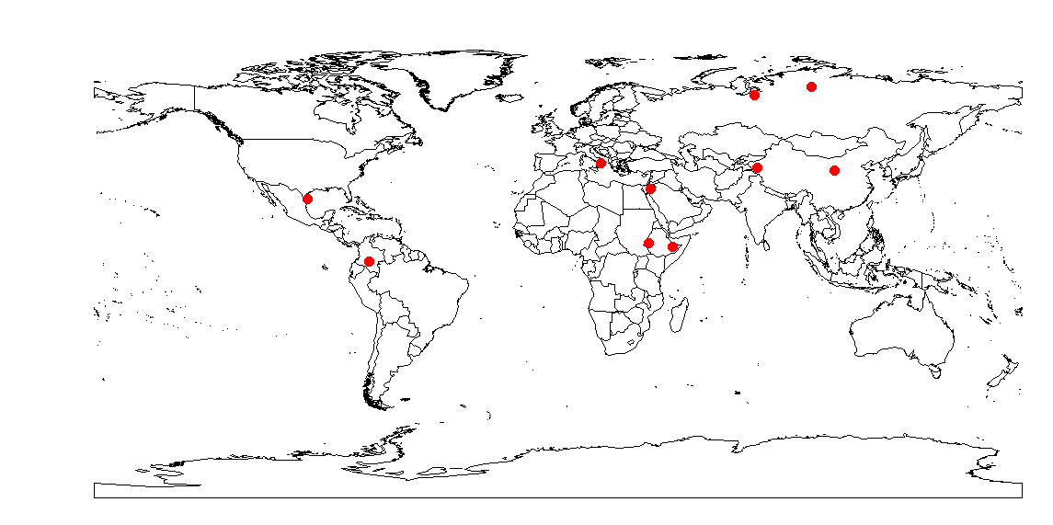
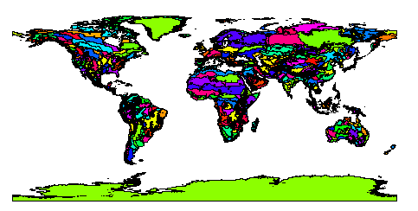
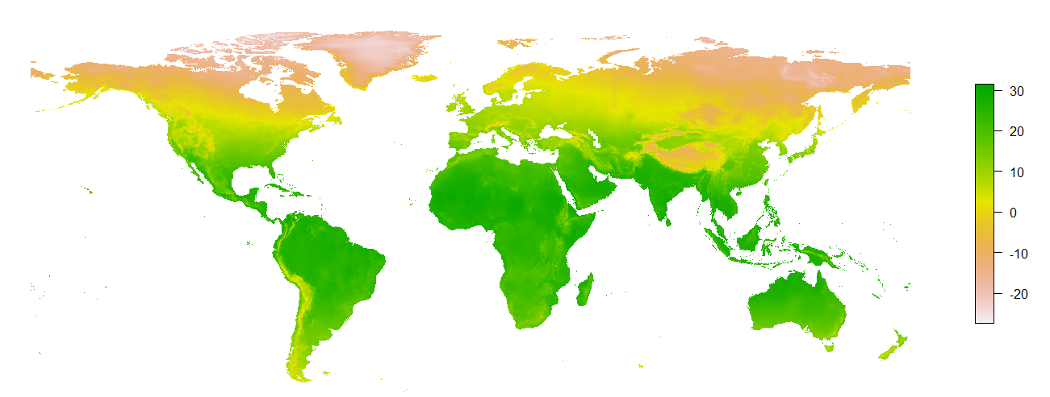
Extracting values for points from rasters and vectors
Sites
Ecoregions
Mean annual temperature

Slide 10
Extraction
extract(raster, points) in raster package
Gives the raster value at those points
over(SpatialPoints, SpatialPolygons) in sp package
Gives the attributes of polygons where points located

Slide 11
Spatial data that we used today
World climate data (worldclim.org)
CHELSA climate data (chelsa-climate.org/)
Human Footprint
Global Population Density
Ecoregions, biomes & realms

Slide 12
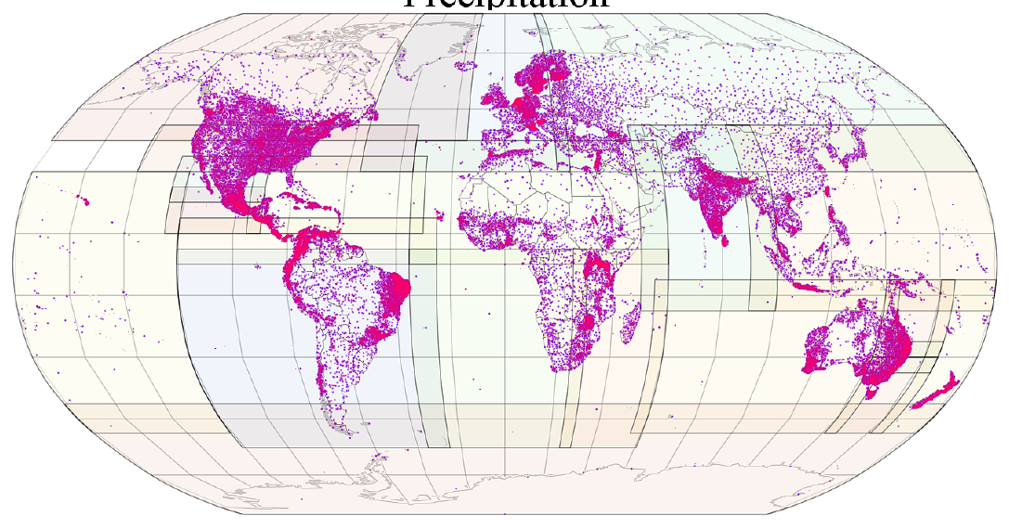
Worldclim
Interpolated from weather station data
Includes monthly temperature, precipitation, and 19 “bioclimatic” variables (climate descriptors considering species physiological requirements)
https://www.worldclim.org/
Fick & Hijmans, 2017, Int. J. Climatol

Slide 13
19 “bioclimatic” variables
BIO1 = Annual Mean Temperature
BIO2 = Mean Diurnal Range (Mean of monthly (max temp - min temp))
BIO3 = Isothermality (BIO2/BIO7) (×100)
BIO4 = Temperature Seasonality (standard deviation ×100)
BIO5 = Max Temperature of Warmest Month
BIO6 = Min Temperature of Coldest Month
BIO7 = Temperature Annual Range (BIO5-BIO6)
BIO8 = Mean Temperature of Wettest Quarter
BIO9 = Mean Temperature of Driest Quarter
BIO10 = Mean Temperature of Warmest Quarter
BIO11 = Mean Temperature of Coldest Quarter
BIO12 = Annual Precipitation
BIO13 = Precipitation of Wettest Month
BIO14 = Precipitation of Driest Month
BIO15 = Precipitation Seasonality (Coefficient of Variation)
BIO16 = Precipitation of Wettest Quarter
BIO17 = Precipitation of Driest Quarter
BIO18 = Precipitation of Warmest Quarter
BIO19 = Precipitation of Coldest Quarter

Slide 14
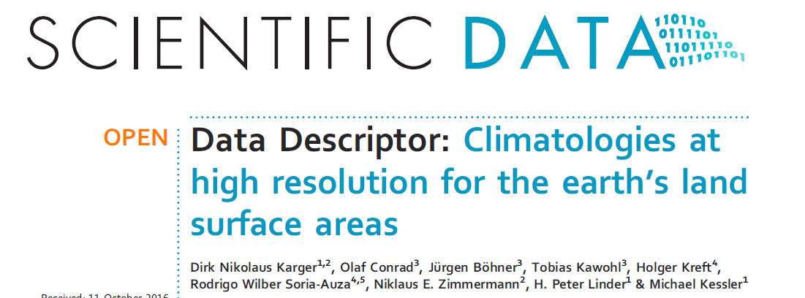

CHELSA – Free climate data at high resolution
Downscaled model output temperature and precipitation estimates at a resolution of 30 arc sec
Near-current, historical (years 21000BP) and future climates
More bioclimatic variables
https://chelsa-climate.org/

Slide 15
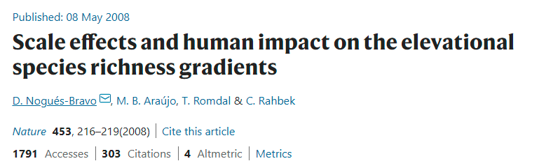
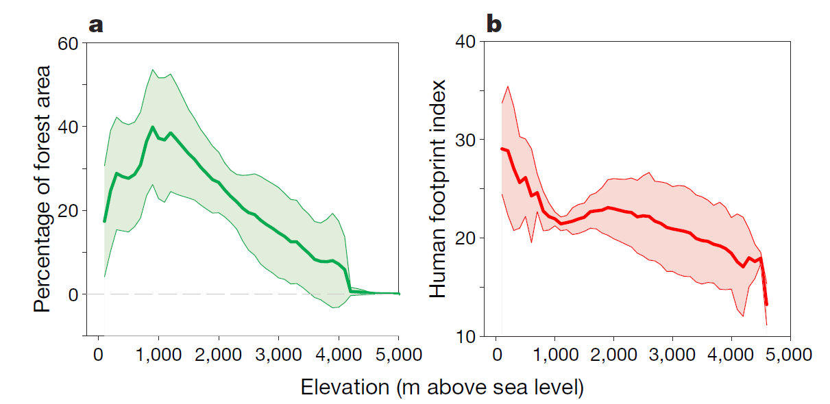
Figure 3 | Worldwide and generalized pattern of human impact along the altitudinal gradient.

Slide 16
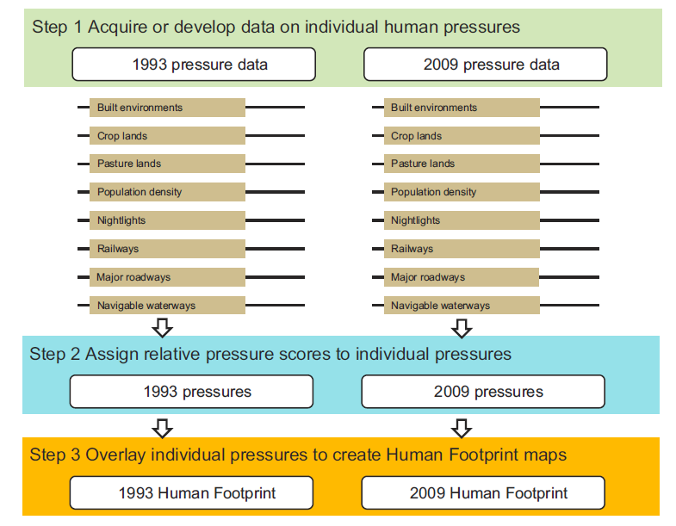
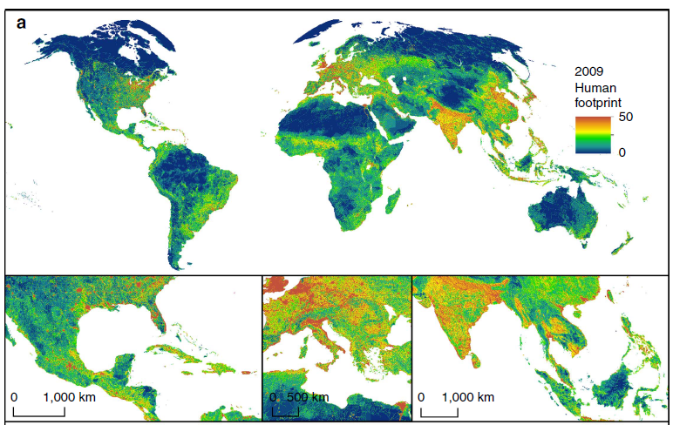
Human Footprint
Integration of eight variables measuring the direct and indirect human pressures
Venter et al. 2016, Nat Comm
Venter et al. 2016, Sci. Data
https://sedac.ciesin.columbia.edu/data/set/wildareas-v3-2009-human-footprint
Notes:
Venter, O., E. W. Sanderson, A. Magrach, J. R. Allan, J. Beher, K. R. Jones, H. P. Possingham, W. F. Laurance, P. Wood, B. M. Fekete, M. A. Levy, and J. E. Watson. 2016. Global Terrestrial Human Footprint Maps for 1993 and 2009. Scientific Data 3:160067. https://doi.org/10.1038/sdata.2016.67.

Slide 17
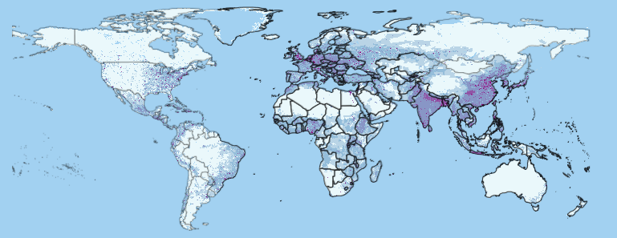
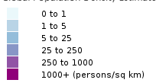
Global Population Density (1970 – 2000)
Global Population Density Estimates at 1970
https://sedac.ciesin.columbia.edu/data/set/popdynamics-global-pop-density-time-series-estimates

Slide 18
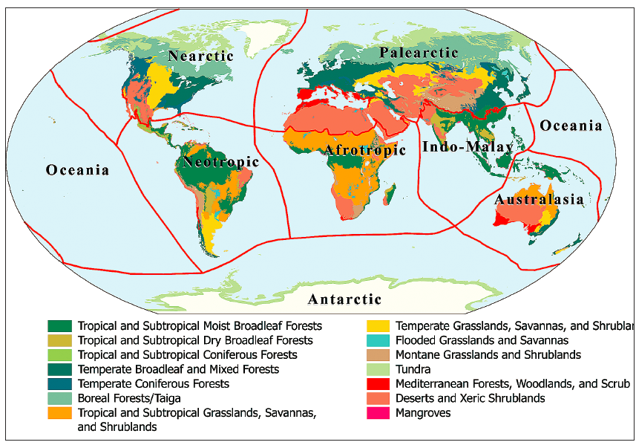
Ecoregions, biomes & realms
Olson et al. 2001, Bioscience
https://ecoregions2017.appspot.com/
Notes:
The RESOLVE Ecoregions dataset, updated in 2017, offers a depiction of the 846 terrestrial ecoregions that represent our living plane

Slide 19
Exercise
Extract spatial data for sites with coordinates

